Slide 1

22MAT230-Mathematics for Computing 4
SVD-based clutter filtering using randomized singular value decomposition and spatial down sampling for micro-vessel imaging on a Verasonics ultrasound system
CB.SC.U4AIE24325-KALLURU ABHISHEK REDDY
CB.SC.U4AIE24365-DASARI RISHIKESH
CB.SC.U4AIE24341-P.MOKSHAGNA ARYAN

Slide 2
Introduction:
Micro-vessel imaging requires ultrafast plane-wave ultrasound for high frame-rate Doppler ensembles
Strong tissue clutter (high spatiotemporal coherence) overlaps with slow blood flow signals
Conventional high-pass filters fail due to spectral overlap
SVD-based clutter filtering is powerful (separates tissue by singular-value ranking)
BUT full SVD is computationally expensive → not real-time on Verasonics (e.g., >5 s per frame)
Proposed solution: Randomized SVD (rSVD) + Randomized Spatial Downsampling (rSD)
Implemented on Vera sonics multi-core CPU using PICMUS pre-beamformed IQ data
Why Micro-vessel imaging?
Detect small blood vessels
Early tumor diagnosis
Micro-circulation monitoring
Functional ultrasound imaging

Slide 3
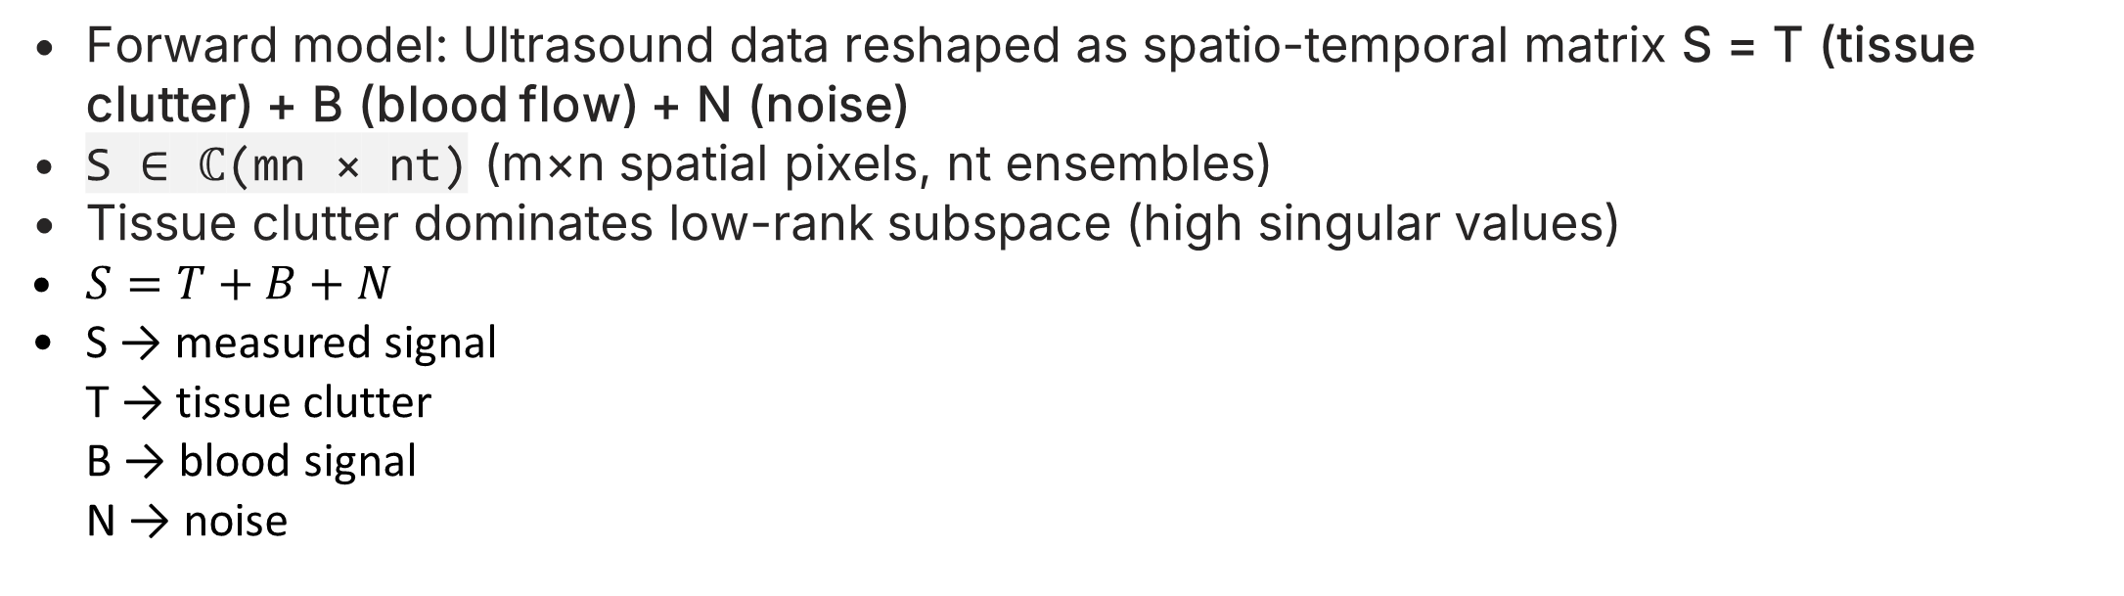
Clutter Filtering Problem Formulation
Forward model: Ultrasound data reshaped as spatio-temporal matrix S = T (tissue clutter) + B (blood flow) + N (noise)
S ∈ ℂ(mn × nt) (m×n spatial pixels, nt ensembles)
Tissue clutter dominates low-rank subspace (high singular values)
$S=T+B+N$
S → measured signal T → tissue clutter B → blood signal N → noise

Slide 4
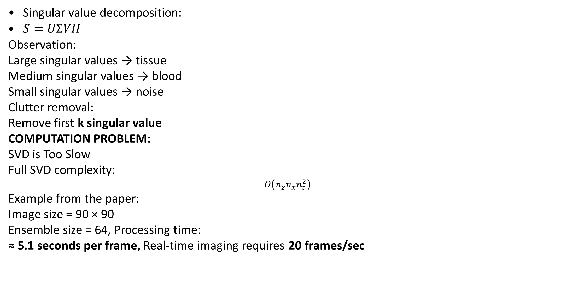
SVD clutter filtering:
Singular value decomposition:
$S=UΣVH$
Observation:
Large singular values → tissue Medium singular values → blood Small singular values → noise
Clutter removal:
Remove first k singular value
COMPUTATION PROBLEM:
SVD is Too Slow
Full SVD complexity:
$$O\left(n_{z}n_{x}n_{t}^{2}\right)$$
Example from the paper:
Image size = 90 × 90 Ensemble size = 64, Processing time:
≈ 5.1 seconds per frame, Real-time imaging requires 20 frames/sec

Slide 5
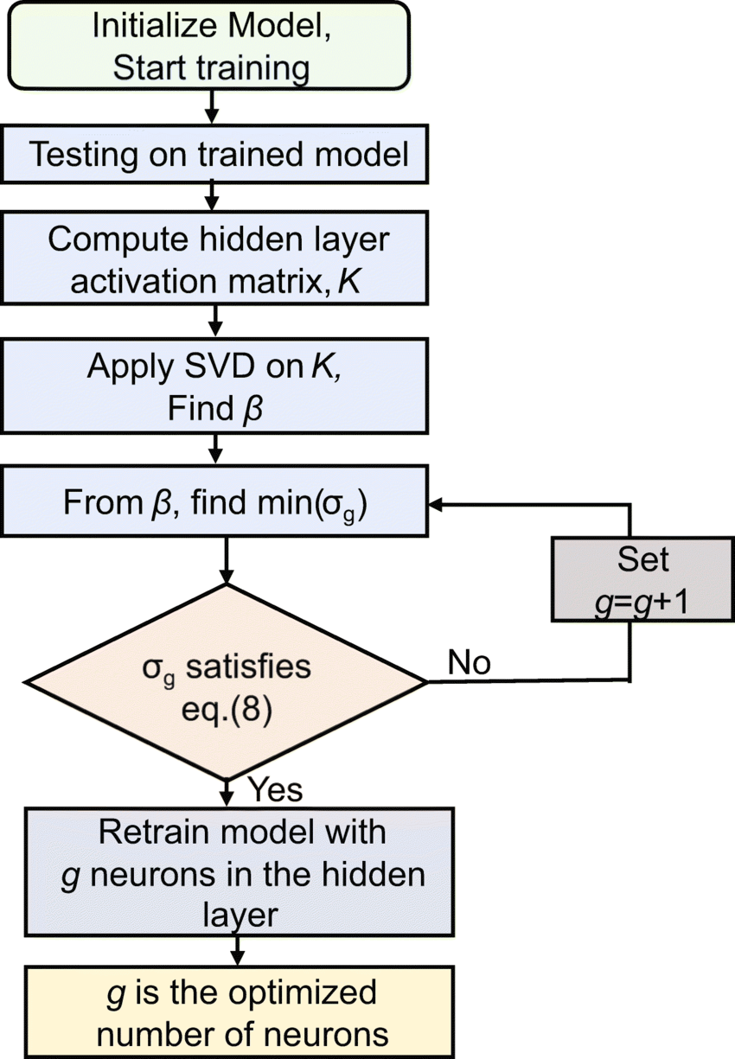
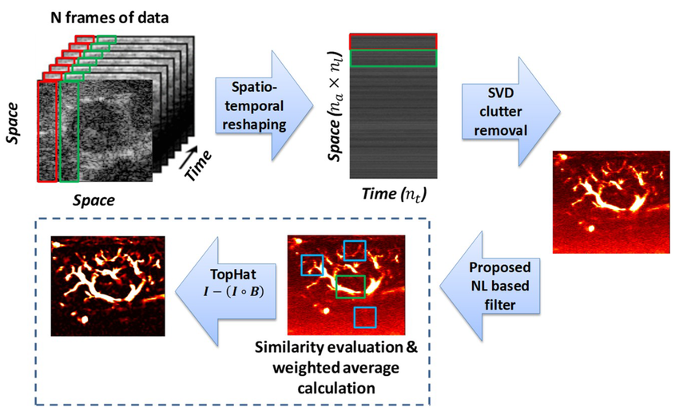

PROPOSED SOLUTION:
Randomized SVD (rSVD)
Randomized Spatial Downsampling (rSD)
Benefits:
• Reduced computation • Parallel processing • Real-time imaging
Randomized SVD Algorithm:
1 Construct spatio-temporal matrix 2 Random projection
$$S^{′}=SR$$
3 QR decomposition 4 Estimate tissue signal 5 Extract blood signal

Slide 6
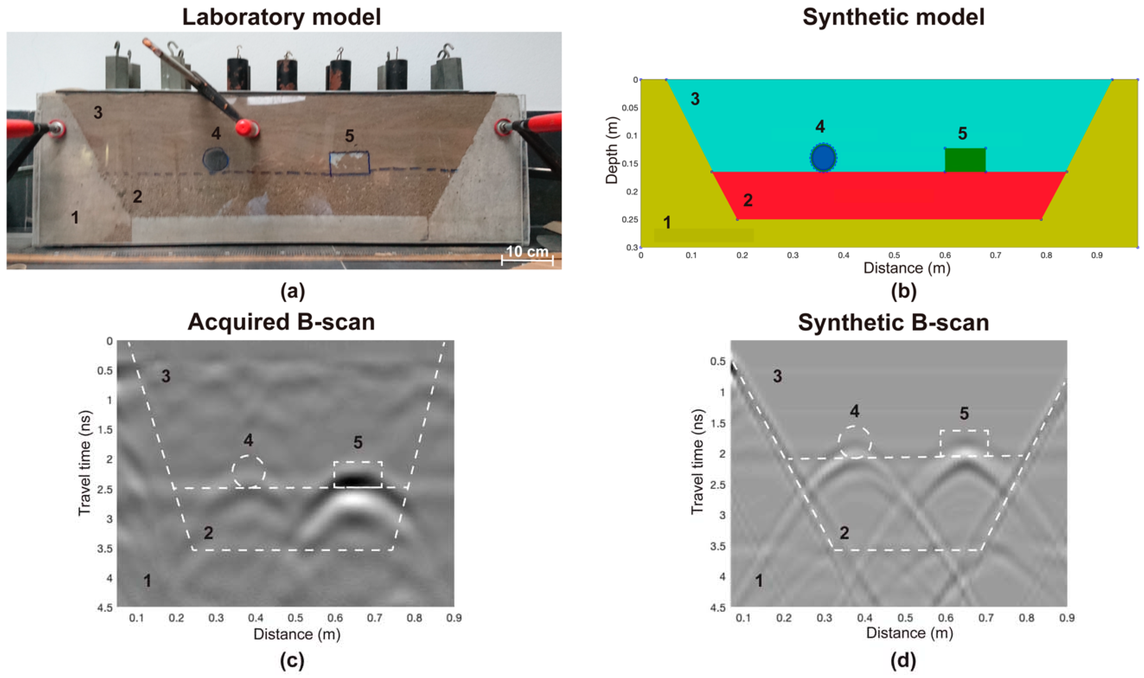
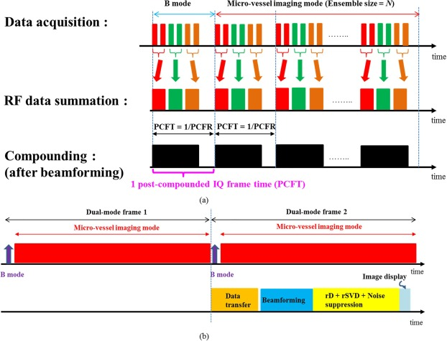

Slide 7
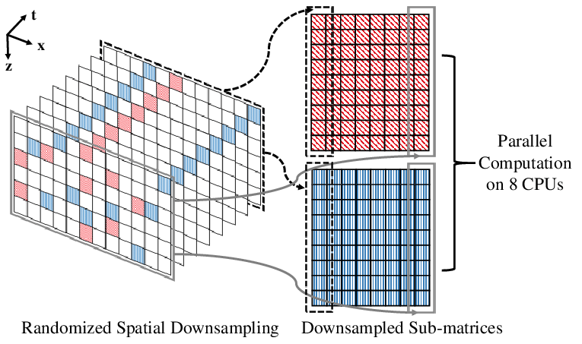
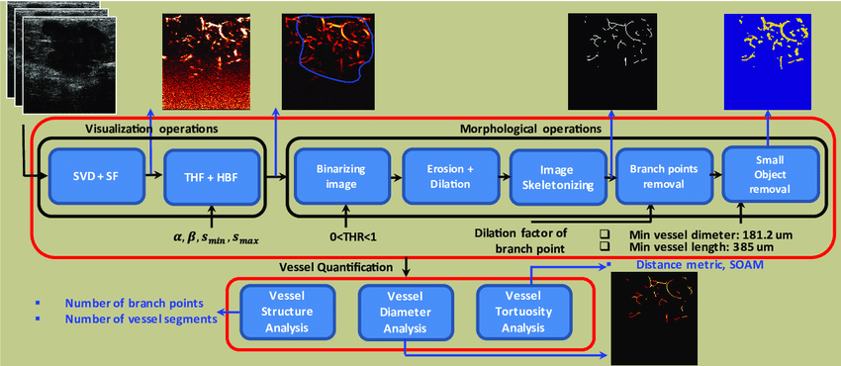
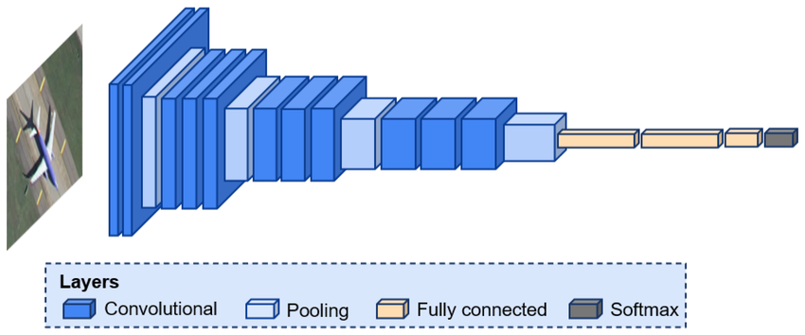
RANDOMISED DOWNSAMPLING:
Divide ROI into smaller blocks • Each block processed independently • Parallel execution on multi-core CPU

Slide 8
Algorithm Steps:
Acquire plane-wave IQ data (PICMUS contrast/speckle or resolution datasets)
Beamform with DAS (use PICMUS /code/image_reconstruction_das) → get IQ buffer
Reshape into spatio-temporal matrix S
rSD: Randomly distribute pixels into parallel sub-matrices
For each block:
Project: S' = S_i × R (random Gaussian matrix)
QR decomposition → approximate tissue subspace
Blood = S_i – T_i
Reassemble full image + noise debiasing
Compute Power Doppler image

Slide 9
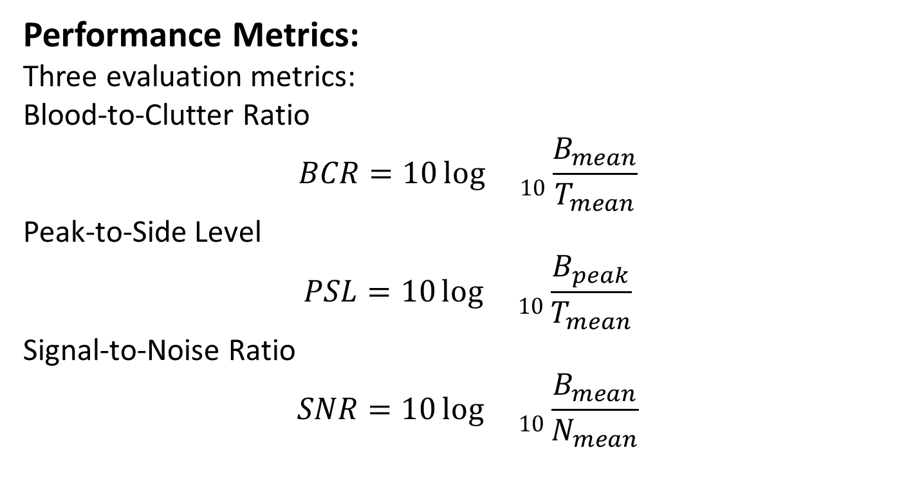
Performance Metrics:
Three evaluation metrics:
Blood-to-Clutter Ratio
$$BCR=10{\log{}}_{10}\frac{B_{mean}}{T_{mean}}$$
Peak-to-Side Level
$$PSL=10{\log{}}_{10}\frac{B_{peak}}{T_{mean}}$$
Signal-to-Noise Ratio
$$SNR=10{\log{}}_{10}\frac{B_{mean}}{N_{mean}}$$

Slide 10
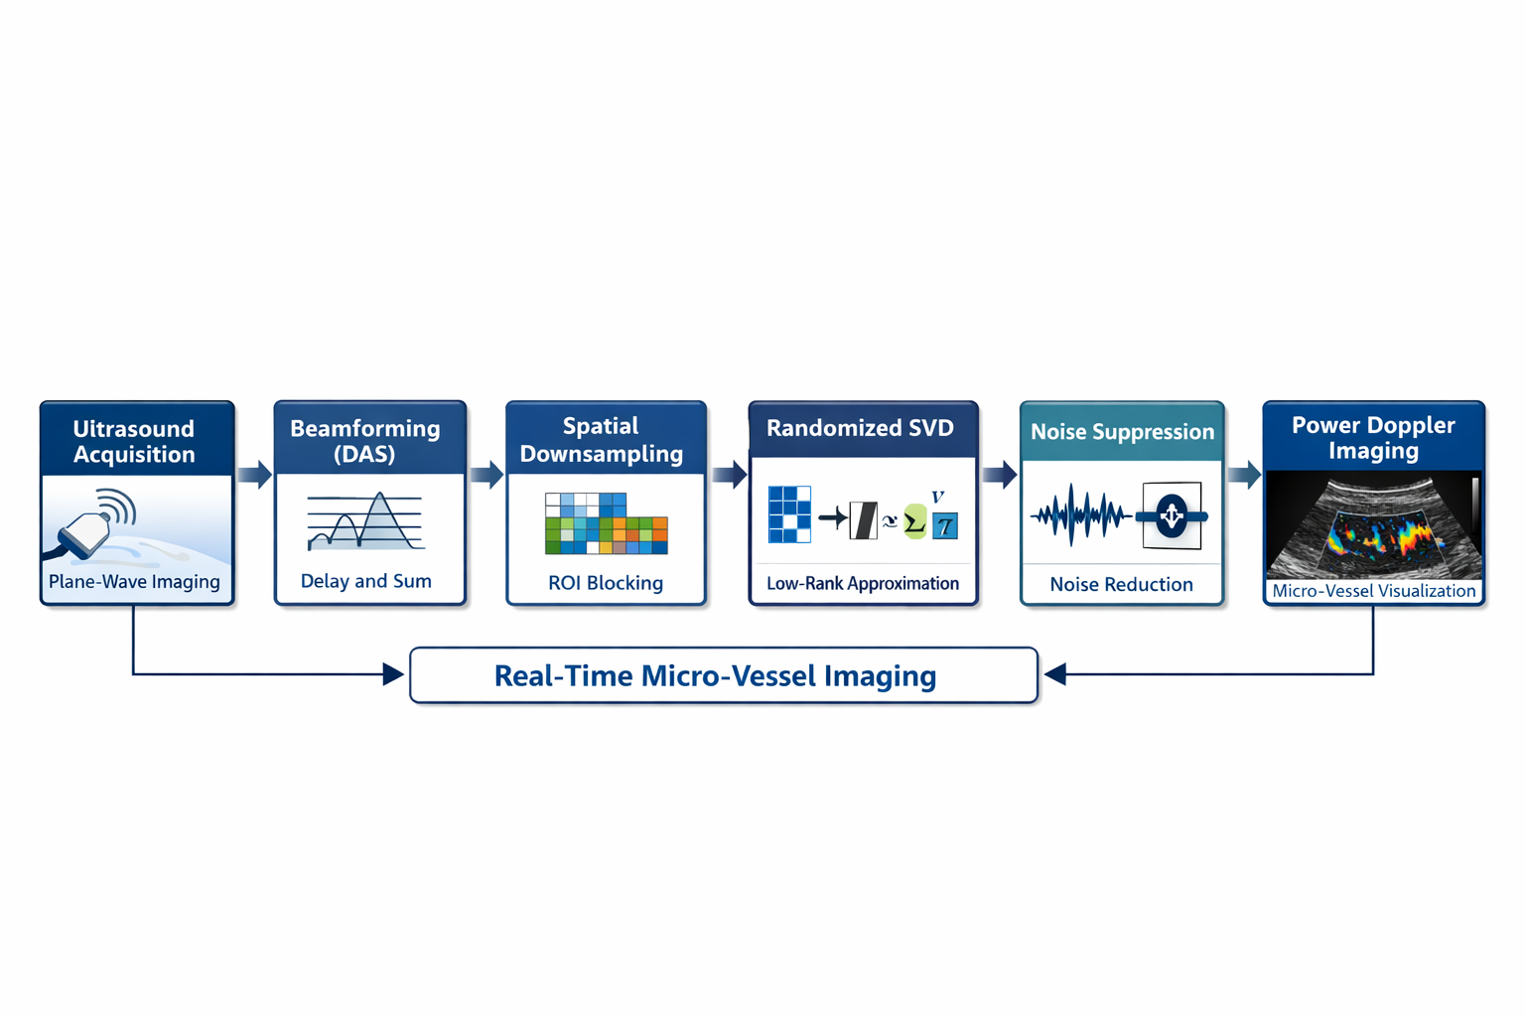
SYSTEM ARCHITECTURE:

Slide 11
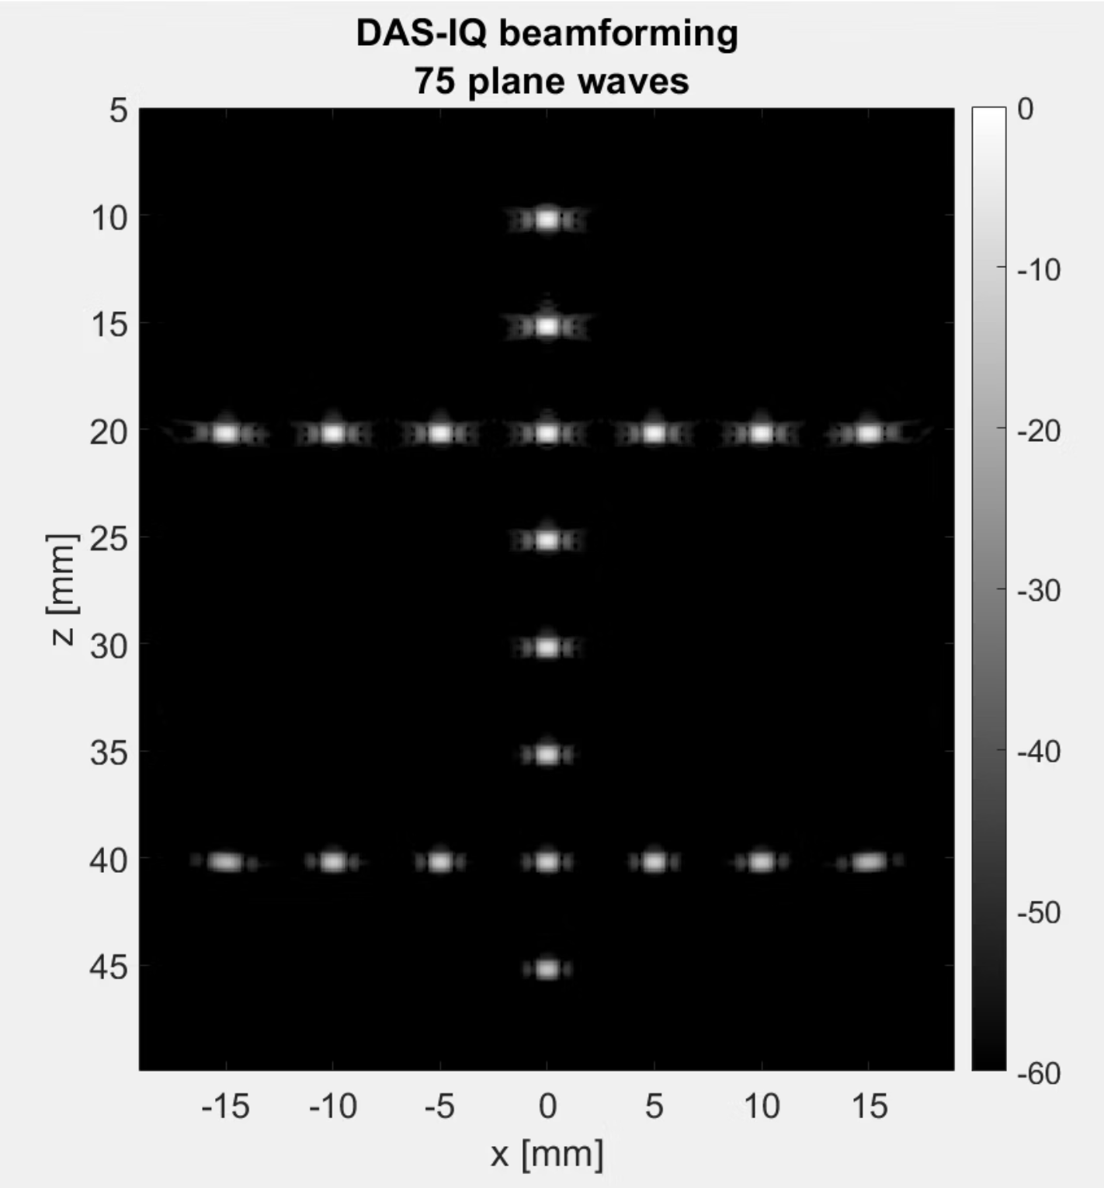
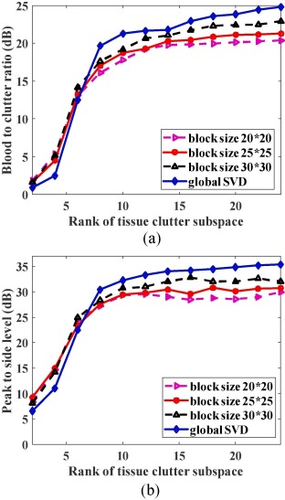
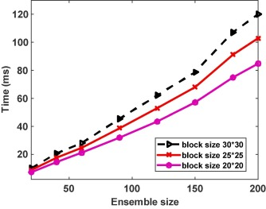
Results

Slide 12
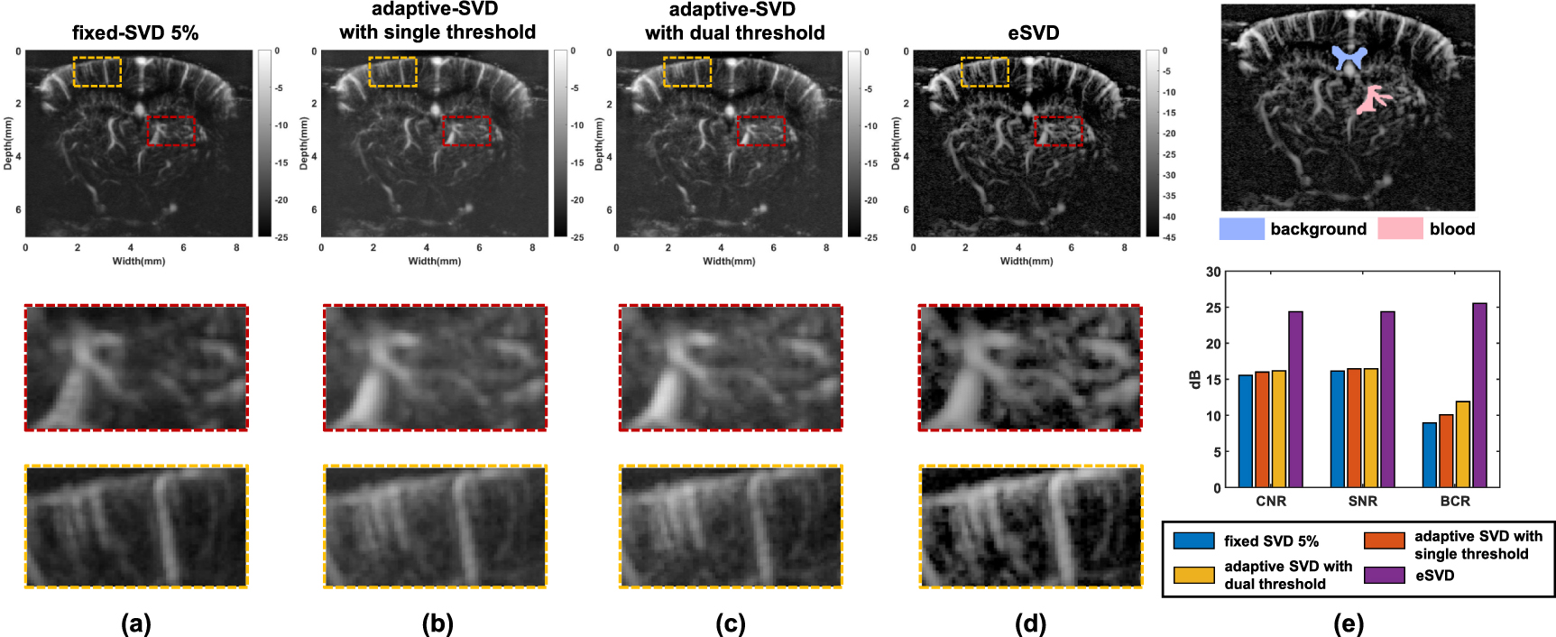

Slide 13
CONCLUSION:
Randomized SVD + Spatial Downsampling
Achievements:
Real-time ultrasound imaging • High clutter suppression • Reduced computational cost
Future work:
• GPU acceleration • 3D micro-vascular imaging

